Slide 1



K. C. COLLEGE OF ENGINEERING AND MANAGEMENT STUDIES AND
RESEARCH
Department Of Information Technology
(Aﬃliated to the University of Mumbai)
Mith Bunder Road, Near Hume Pipe, Kopari, Thane(E)-400603
Excelssior Education Society’s
K.C. COLLEGE OF ENGINEERING & MANAGEMENT STUDIES & RESEARCH
(Affiliated to the University of Mumbai)

Slide 2
INTERNAL PRESENTATION
SEM-III(2024-2025)
Excelssior Education Society’s
K.C. COLLEGE OF ENGINEERING & MANAGEMENT STUDIES & RESEARCH
(Affiliated to the University of Mumbai)

Slide 3
Codemaster
Group members
1)Shubham Gupta 19
2)Nitesh Gupta 18
3)Ayush Jha 24
4)Mohd Talha Faizan 53
5)Amarja Adgaonkar Guide
Excelssior Education Society’s
K.C. COLLEGE OF ENGINEERING & MANAGEMENT STUDIES & RESEARCH
(Affiliated to the University of Mumbai)

Slide 4
Index
Introduction
Need / Motivation
Problem Definition
Literature Survey
Existing Methodology
Challenges in Existing Methodology
Proposed System
Design – Class Diagram
Hardware and Software Requirements
Implementation Plan
Conclusion
References
Excelssior Education Society’s
K.C. COLLEGE OF ENGINEERING & MANAGEMENT STUDIES & RESEARCH
(Affiliated to the University of Mumbai)

Slide 5
INTRODUCTION
This project focuses on addressing the growing demand for programming skills by creating a coding learning application. It is designed to teach four widely-used programming languages—C, C++, Java, and Python—catering to both beginners and intermediate learners.
Key features include:
Chapter-wise notes to build foundational knowledge for each language.
Coding questions that users can solve directly within the application using an in-built compiler.
Multi-language support, allowing users to switch between languages for broader learning.
A user management system integrated with a database that securely stores user details, though it currently does not track progress.
The platform is structured to provide both educational resources and practical coding experience, making it an efficient and engaging tool for learning programming. Future enhancements may include personalized learning paths and performance tracking.
Excelssior Education Society’s
K.C. COLLEGE OF ENGINEERING & MANAGEMENT STUDIES & RESEARCH
(Affiliated to the University of Mumbai)

Slide 6
NEED / MOTIVATION
The need/motivation for developing the "CodeMaster" coding learning platform is rooted in the growing demand for programming skills in the rapidly evolving digital world. As technology becomes more integrated into various industries and everyday life, there is an increasing requirement for effective, accessible, and engaging ways to learn programming.
The project aims to address this need by providing a structured platform where users can learn and practice widely-used programming languages (C, C++, Java, Python) through chapter-wise notes and an integrated compiler. This application caters to both beginners and intermediate learners, making the coding process seamless and interactive, thus enhancing programming skills efficiently and effectively​
Excelssior Education Society’s
K.C. COLLEGE OF ENGINEERING & MANAGEMENT STUDIES & RESEARCH
(Affiliated to the University of Mumbai)

Slide 7
PROBLEM DEFINITION
The problem definition for the "CodeMaster" project is to build a user-friendly, intuitive coding learning platform that offers a seamless experience for users learning and practicing programming in C, C++, Java, and Python.
Key objectives include:
Engaging Learning Experience: Provide an intuitive platform for users to learn and practice coding with a focus on user-friendliness.
Structured Learning Paths: Offer chapter-wise notes guiding users from basic to advanced concepts.
3.Hands-on Coding Practice: Integrate a built-in compiler for users to write, run, and test their code directly within the application.
4.Personalized User Management: Store user details securely for potential future personalization features like progress tracking.
5.Multi-language Support: Consolidate the learning process for multiple programming languages in one platform
Excelssior Education Society’s
K.C. COLLEGE OF ENGINEERING & MANAGEMENT STUDIES & RESEARCH
(Affiliated to the University of Mumbai)

Slide 8
LITERATURE SURVEY
Sr.No | Title of Paper / website | Methodology used | Advantage | Limitations / Challenges
1 | A Novel Approach to Coding Education | Developed a web-based platform integrating exercises with tutorials | Seamless integration of tutorials and exercises | Limited to one programming language (Python).
2 | Improving Online Learning for Coders | Used data analytics to provide personalized content to learners | Personalized learning paths improve user engagement. | High server costs for data processing.
3 | Interactive Coding Platforms for Beginners | Built an interactive, gamified platform with real-time code validation. | Real-time feedback encourages hands-on learning. | Requires constant internet connection.
Excelssior Education Society’s
K.C. COLLEGE OF ENGINEERING & MANAGEMENT STUDIES & RESEARCH
(Affiliated to the University of Mumbai)

Slide 9
EXISTING METHODOLOGY
Existing Methodology in LeetCode
Problem Library: Extensive coding problems with different difficulty levels for practice.
Real-Time Feedback: Immediate feedback on code submissions with pass/fail results.
Learning Paths: Guided problem-solving through Explore Cards for various topics.
Community Solutions: Users share solutions and access official editorials.
Progress Tracking: Tracks performance, offers badges, and ranks solutions.
Competitive Contests: Regular coding contests for timed problem-solving.
Summary: LeetCode focuses on problem-solving, competitive programming, and interview preparation, providing instant feedback and a strong community, but lacks foundational learning support.
Excelssior Education Society’s
K.C. COLLEGE OF ENGINEERING & MANAGEMENT STUDIES & RESEARCH
(Affiliated to the University of Mumbai)

Slide 10
CHALLENGES IN EXISTING METHODOLOGY
High Learning Curve: Beginners may find the platform overwhelming.
Limited Tutorials: Lacks structured foundational lessons for in-depth learning.
Quality Control in Solutions: User-generated solutions vary, confusing beginners.
Limited Personalization: Doesn't offer personalized learning based on user performance.
Summary: LeetCode's strengths in problem-solving are counterbalanced by challenges for beginners, such as a lack of guided learning paths and real-world coding simulations.
Excelssior Education Society’s
K.C. COLLEGE OF ENGINEERING & MANAGEMENT STUDIES & RESEARCH
(Affiliated to the University of Mumbai)

Slide 11
PROPOSED METHODOLOGY
Structured Learning Paths: Chapter-wise lessons for C, C++, Java, and Python, with a beginner-friendly approach.
Integrated Local Compiler: Real-world coding experience with local compilation in the app.
Curated Solutions: High-quality, verified solutions to help users understand problem-solving approaches.
Summary
The existing LeetCode methodology is strong for competitive programming but lacks beginner-friendly features and real-world coding experiences. The proposed methodology introduces chapter-based learning, personalized progress tracking, and local code compilation, making the platform more accessible and effective for learners at all levels.
Excelssior Education Society’s
K.C. COLLEGE OF ENGINEERING & MANAGEMENT STUDIES & RESEARCH
(Affiliated to the University of Mumbai)

Slide 12
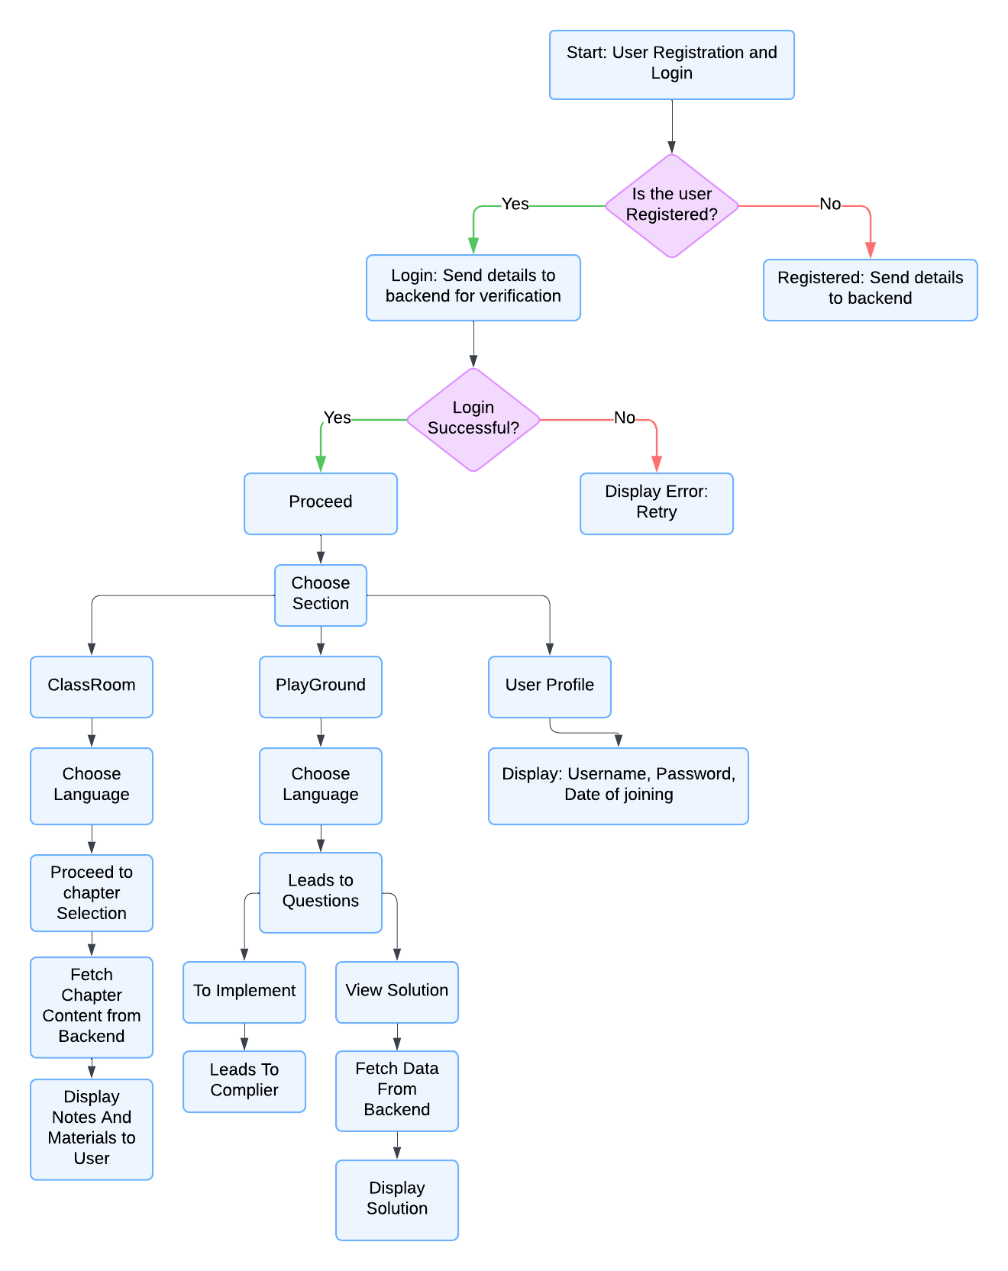
FLOWCHART
Excelssior Education Society’s
K.C. COLLEGE OF ENGINEERING & MANAGEMENT STUDIES & RESEARCH
(Affiliated to the University of Mumbai)

Slide 13
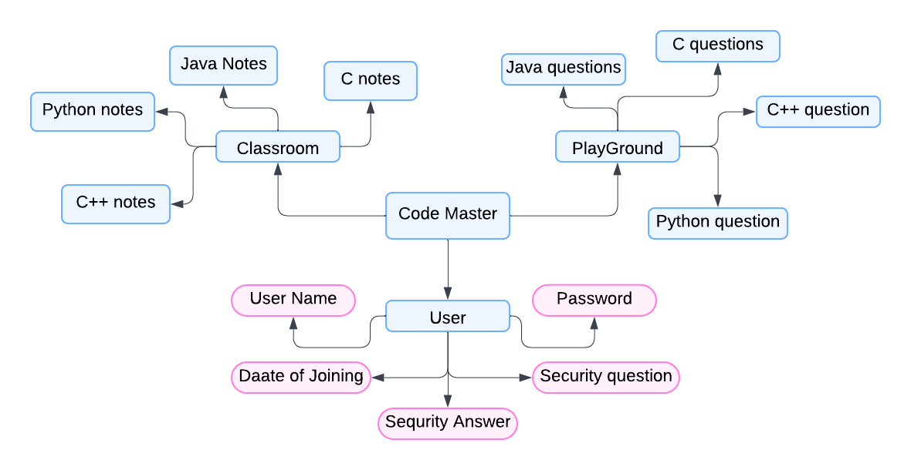
DESIGN – (CLASS DIAGRAM)
Excelssior Education Society’s
K.C. COLLEGE OF ENGINEERING & MANAGEMENT STUDIES & RESEARCH
(Affiliated to the University of Mumbai)

Slide 14
HARDWARE AND SOFTWARE REQUIREMENTS
Hardware Requirements (PC/Laptop Configuration):
Processor: Minimum dual-core processor (e.g., Intel i3 or equivalent).
RAM: At least 4 GB of RAM (8 GB recommended for better performance).
Storage: Minimum of 500 MB of available disk space for the application, along with additional space for user data.
Graphics: Integrated graphics that support JavaFX applications
Excelssior Education Society’s
K.C. COLLEGE OF ENGINEERING & MANAGEMENT STUDIES & RESEARCH
(Affiliated to the University of Mumbai)

Slide 15
For server-side (if hosted on a dedicated server):
Processor: Quad-core processor (e.g., Intel Xeon or equivalent).
RAM: Minimum 16 GB (32 GB recommended for handling multiple user sessions).
Storage: SSD with at least 100 GB of available space for database and application data.
Network: High-speed internet connection to handle concurrent users​.
Software Requirements:
Front End: JavaFX for building the user interface, with the help of Scene Builder for UI layout. The integrated development environment (IDE) used is unspecified but could be typical Java IDEs like Eclipse or IntelliJ IDEA.
Back End: The backend uses a relational database such as MySQL for user authentication, chapter content management, and storing user interactions​

Slide 16
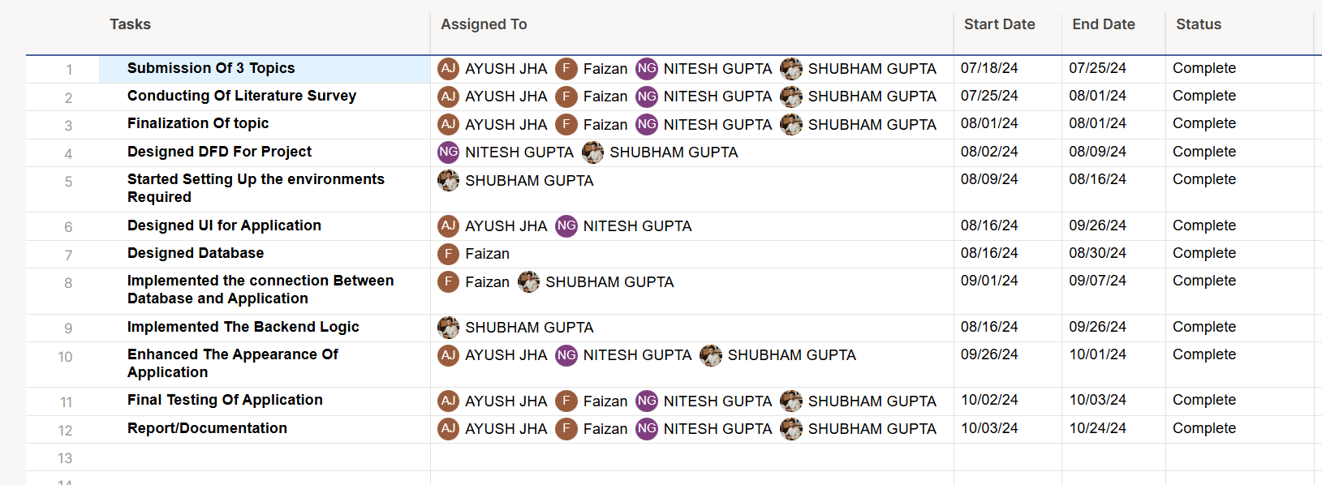
IMPLEMENTATION PLAN
Excelssior Education Society’s
K.C. COLLEGE OF ENGINEERING & MANAGEMENT STUDIES & RESEARCH
(Affiliated to the University of Mumbai)

Slide 17
CONCLUSION
The platform successfully integrates technologies like JavaFX, Scene Builder, and local compilers (GCC, JDK, and Python interpreter) to provide an interactive coding learning environment. It supports multiple programming languages and allows users to practice coding with real-time execution without the need for constant internet access, offering a distinct advantage in certain markets.
Key points of the conclusion:
Multi-language support: The platform offers C, C++, Java, and Python, providing learners with flexibility.
Real-time code execution: Using local compilers gives users a real-time coding experience, similar to working in standalone integrated development environments (IDEs).
Excelssior Education Society’s
K.C. COLLEGE OF ENGINEERING & MANAGEMENT STUDIES & RESEARCH
(Affiliated to the University of Mumbai)

Slide 18
Efficient frontend and backend: The system demonstrates strong frontend design with JavaFX, while the backend efficiently handles user management and chapter content delivery.
Scalability: The project is designed for future enhancements such as progress tracking, personalized learning paths, and analytics to increase user engagement.
Cost-effective: The use of local compilers minimizes dependence on expensive cloud APIs, making it budget-friendly.
Overall, the platform serves as a robust solution for learners aiming to improve their coding skills across multiple programming language

Slide 19
REFERENCES
GeeksforGeeks – https://www.geeksforgeeks.org/
Coursera – https://www.coursera.org/
Khan Academy (Computer Programming) – https://www.khanacademy.org/computing/computer-programming
W3Schools – https://www.w3schools.com/
edX (Computer Science Courses) – https://www.edx.org/learn/computer-science
HackerRank – https://www.hackerrank.com/
LeetCode – https://leetcode.com/
Udemy (Programming Courses) – https://www.udemy.com/topic/programming-languages/
Stack Overflow – https://stackoverflow.com/
GitHub – https://github.com/
Real Python – https://realpython.com/
JavaTPoint – https://www.javatpoint.com/
TutorialsPoint – https://www.tutorialspoint.com/
Programiz – https://www.programiz.com/
Sololearn – https://www.sololearn.com/
Educative – https://www.educative.io/
MIT OpenCourseWare – https://ocw.mit.edu/
CS50 (Harvard's Intro to Computer Science) – https://cs50.harvard.edu/
Excelssior Education Society’s
K.C. COLLEGE OF ENGINEERING & MANAGEMENT STUDIES & RESEARCH
(Affiliated to the University of Mumbai)

